Slide 1



39th ESMO, Madrid, 26-30 Sept 2014
prIME Oncology Symposium
How Do You Measure Success?
Recent Progress in Breast Cancer
Martine J. Piccart-Gebhart, MD, PhD
Jules Bordet Institute, Brussels, Belgium
Université Libre de Bruxelles
Breast International Group (BIG aisbl), Chair

Slide 2

Recent Progress in the Management of
Breast Cancer
Chapter 1
« Luminal »
BC
Notes:
This evolution regarding breast cancer taxonomy parallels the technological evolution (I would say revolution) that we have been witnessing for several years and that we can use for molecular characterization of BC.
In the early 70’s we had just one marker, the ER.
In the 90’s we had two markers, the ER and HER2.
Today we have in our hands potentially several hundred of markers that can be used, and some of them are already used in the clinic for treatment decision making–see oncotypeDX.
But most importantly, tomorrow (and this is not very far from now), because of the dramatic and unpredictable technological and analytical advances (such as NGS etc…), it is expected that we will have in our office using our laptops or ipads, all the biological information needed for either treatment decision making or clinical research!

Slide 3
All our endocrine therapies fail… sooner or later, in view of the development of “ENDOCRINE RESISTANCE” We have agreed on a definition of “endocrine resistance”!

Slide 4
ABC Consensus on the Definition of "Endocrine Resistance"
Prior exposure to adjuvant ET
Yes
No
Relapse on adjuvant ET
Best response to first-line ET
Yes
No
Free interval since completion
of adjuvant ET
(≥4 years)
First
2 years
>2 years
PD within
3 months
PD within
3-9 months
PD within
9-24 months
PD after
24 months
<1 year
>1 year
Subsequent ET probability of response
Subsequent ET probability of response
Very low
Very low
Low
Low
Medium
Medium
High
High
Gradient of response probabilities to further hormonal manipulation
« ABC Lisbon » consensus definitions of primary endocrine resistance
ET, endocrine therapy

Slide 5
Endocrine-Resistant Breast Cancer
Epigenetic silencing
of the ESR1 gene
ENDOCRINE RESISTANCE
MECHANISMS
2. ESR1 mutations
3. Upregulation of alternative signal transduction pathways

Slide 6
Mutations in Estrogen Receptor (ESR1) Are Enriched in Metastatic Samples Compared With Primary
P535H
L536R
Y537C/N/S (5)
D538G (3)
R555C
Mutations not previously described in COSMIC are colored in blue
E380Q
V392I
H6Y (3)
S118P (3)
R269C (3)
S463P
End.
Resist.
BC
Transactivation (AF1)
DNA binding
Hinge
Transactivation (AF2), Steroid binding
1
184
250
310
595
Mutations are enriched in metastatic samples compared with primary samples
Cluster of 11 mutations (between amino acids 535 and 538) in ligand-binding domain likely affect affinity and binding kinetics of estrogen
Example: Y537S mutant is constitutively active in the absence of ligand
Most of these mutations will ultimately lead to increased ER signaling, through constitutive, ligand-independent transactivation
Gene | Met With Variant | Met Without Variant | % Mets | Primary With Variant | Primary Without Variant | % Primary
ESR1 | 8 | 34 | 19.0 | 13 | 172 | 7.0
ER
mutations
Lazennec G, et al. Mol Endocrinol. 1997;11(9):1375-1386.

Slide 7
Targeting the cell cycle progression downstream of the “activated” ER: An efficient strategy for antagonizing constitutive ERα signaling ?

Slide 8
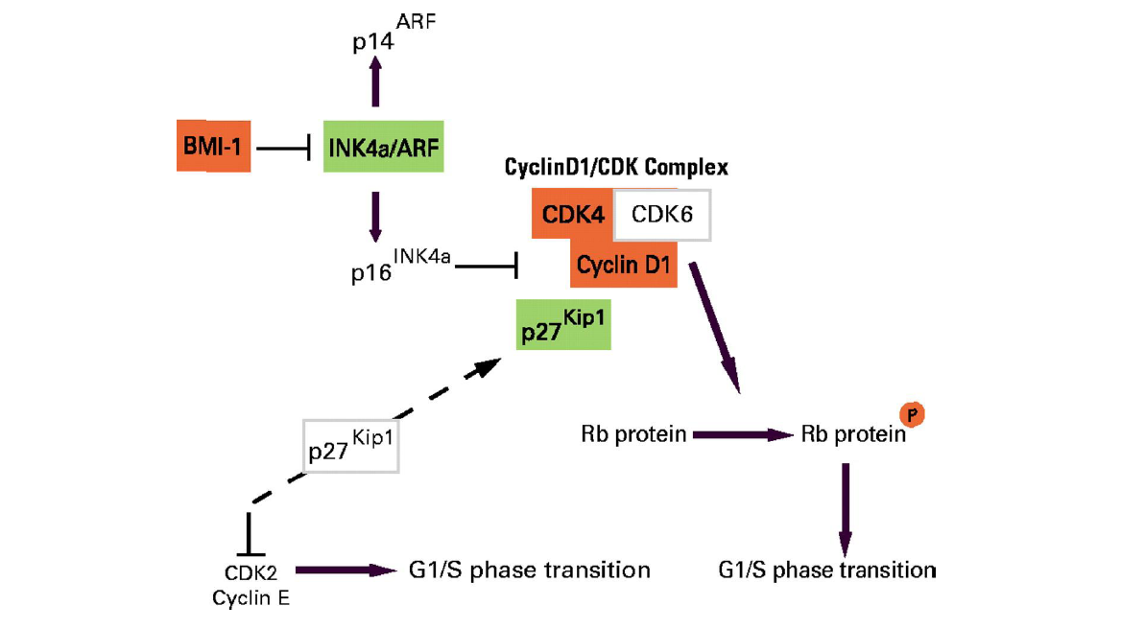
Role of CDK4 in Cell Cycle
CDK4-6
Inhibitor
Many mitogenic signals converge at cyclin D1!
↑cyclin D1/CDK4-6 "traps" p27 away from cyclin E/CDK2, which will then also phosphorylate Rb
Phosphorylated Rb = positive regulator of G1/s transition
Fernàndez V, et al. J Clin Oncol. 2005;23(26):6364-6369.

Slide 9

PALOMA-1 : Progression-Free Survival (ITT) Part 1 and Part 2
Part 1 | PAL + LET (N = 34) | LET (N = 32)
Number of Events (%) | 15 (44) | 25 (78)
Median PFS, months (95% CI) | 26.1 (11.2, NR) | 5.7 (2.6, 10.5)
Hazard Ratio (95% CI) | 0.299 (0.156, 0.572)
P value | <.0001
Part 2 | PAL + LET (N = 50) | LET (N = 49)
Number of Events (%) | 26 (52) | 34 (69)
Median PFS, months (95% CI) | 18.1 (13.1, 27.5) | 11.1 (7.1, 16.4)
Hazard Ratio (95% CI) | 0.508 (0.303, 0.853)
P value | .0046
Finn RS, et al. Proceedings of the 105th Annual Meeting of the American Association for Cancer Research; 2014 Apr 5-9; San Diego, CA. Philadelphia (PA): AACR; 2014. Abstract CT101.
9
This agent may not be currently approved by the US Food and Drug Administration or European Medicines Agency for this indication.

Slide 10
PALOMA-1 : Progression-Free Survival (ITT) Part 1 and Part 2
Part 1 | PAL + LET (N = 34) | LET (N = 32)
Number of Events (%) | 15 (44) | 25 (78)
Median PFS, months (95% CI) | 26.1 (11.2, NR) | 5.7 (2.6, 10.5)
Hazard Ratio (95% CI) | 0.299 (0.156, 0.572)
P value | <.0001
Part 2 | PAL + LET (N = 50) | LET (N = 49)
Number of Events (%) | 26 (52) | 34 (69)
Median PFS, months (95% CI) | 18.1 (13.1, 27.5) | 11.1 (7.1, 16.4)
Hazard Ratio (95% CI) | 0.508 (0.303, 0.853)
P value | .0046
Encouraging results… but
randomized phase II, not III
Finn RS, et al. Proceedings of the 105th Annual Meeting of the American Association for Cancer Research; 2014 Apr 5-9; San Diego, CA. Philadelphia (PA): AACR; 2014. Abstract CT101.
10
This agent may not be currently approved by the US Food and Drug Administration or European Medicines Agency for this indication.

Slide 11
Ongoing Phase III Studies Assessing CDK 4/6 Inhibition
PALOMA-2
Palbociclib + Letrozole vs. Letrozole For 1st Line Treatment Of Postmenopausal Women (NCT01740427)
PALOMA-3
Palbociclib + Fulvestrant vs. Fulvestrant + Placebo After Endocrine Failure (NCT01942135)
PEARL
Palbociclib + Exemestane vs. Capecitabine in Resistance to NSAI (NCT02028507)
MONARCH2
Fulvestrant With or Without Abemaciclib (LY2835219) (NCT02107703)
MONALEESA2
LEE011 in Combination With Letrozole (NCT01958021)

Slide 12
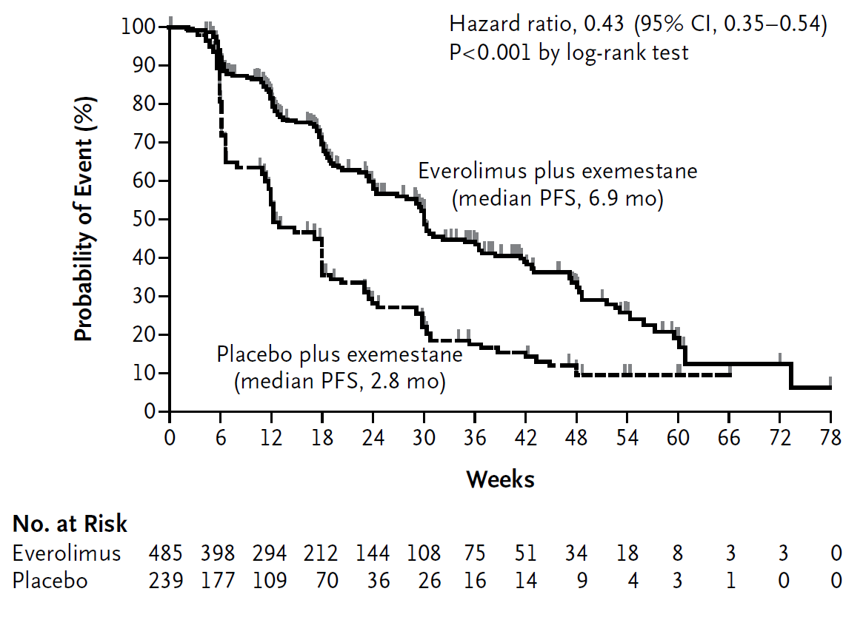
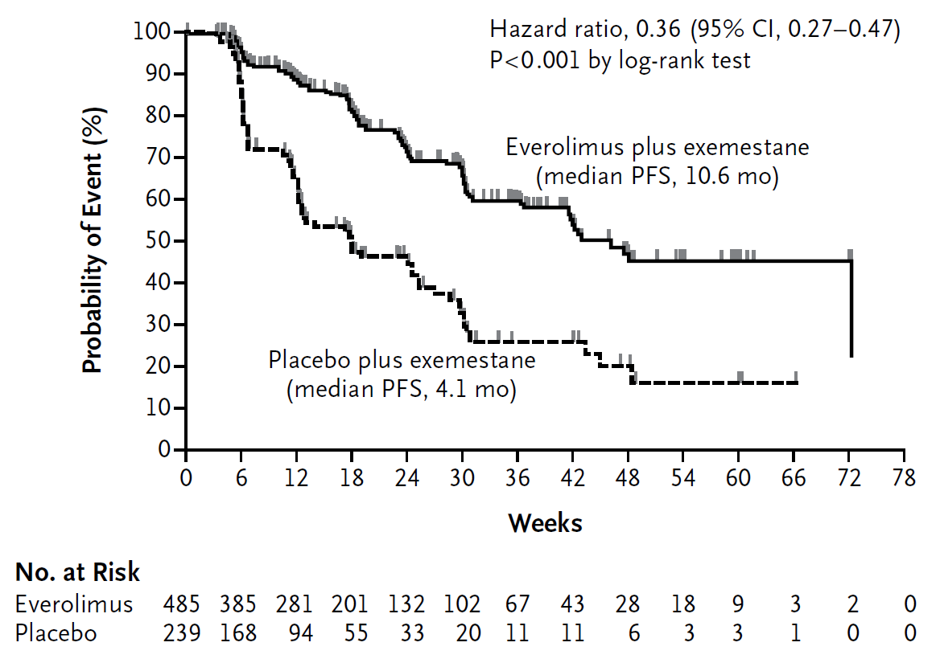
BOLERO-2 Study: Results
Local Assessment
Central Assessment
Baselga J, et al. N Engl J Med. 2012;366(6):520-529.

Slide 13
BOLERO-2 Study: Results
Local Assessment
Central Assessment
A significant step forward in a series of attempts
to prolong the use of endocrine therapy for MBC
Baselga J, et al. N Engl J Med. 2012;366(6):520-529.

Slide 14
BOLERO-2: Most Common G3/4 AEs
 | Everolimus + Exemestane (N = 482), % |  |  | Placebo + Exemestane (N = 238), %
 | All Grades | Grade 3 | Grade 4 | All Grades | Grade 3 | Grade 4
Stomatitis | 56 | 8 | 0 | 11 | 1 | 0
Fatigue | 33 | 3 | <1 | 26 | 1 | 0
Dyspnea | 18 | 4 | 0 | 9 | 1 | <1
Anemia | 16 | 5 | 1 | 4 | <1 | <1
Hyperglycemia | 13 | 4 | <1 | 2 | <1 | 0
AST | 13 | 3 | <1 | 6 | 1 | 0
Pneumonitis | 12 | 3 | 0 | 0 | 0 | 0
AE, Adverse Event; AST, Aspartate aminotransferase
Baselga J, et al. N Engl J Med. 2012;366(6):520-529.

Slide 15
BOLERO-2: Most Common G3/4 AEs
 | Everolimus + Exemestane (N = 482), % |  |  | Placebo + Exemestane (N = 238), %
 | All Grades | Grade 3 | Grade 4 | All Grades | Grade 3 | Grade 4
Stomatitis | 56 | 8 | 0 | 11 | 1 | 0
Fatigue | 33 | 3 | <1 | 26 | 1 | 0
Dyspnea | 18 | 4 | 0 | 9 | 1 | <1
Anemia | 16 | 5 | 1 | 4 | <1 | <1
Hyperglycemia | 13 | 4 | <1 | 2 | <1 | 0
AST | 13 | 3 | <1 | 6 | 1 | 0
Pneumonitis | 12 | 3 | 0 | 0 | 0 | 0
Discontinuation of treatment due to side effects :
19% vs 4%
AE, Adverse Event; AST, Aspartate aminotransferase
Baselga J, et al. N Engl J Med. 2012;366(6):520-529.

Slide 16
BOLERO-2 (39-mo): Final OS Analysis
HR = 0.89 (95% CI, 0.73-1.10)
Log-rank P = .14
Kaplan-Meier medians
EVE+EXE: 30.98 months
PBO+EXE: 26.55 months
Censoring times
No. at risk
EVE+EXE
PBO+EXE
485
239
471
232
448
220
429
211
414
201
399
194
373
182
347
170
330
162
311
153
292
145
279
130
266
120
248
113
232
109
216
102
196
98
154
77
118
56
91
41
58
28
39
18
23
8
11
5
1
1
0
0
At 39 months’ median follow-up, 410 deaths had occurred (data cutoff date: 03 October 2013)
267 deaths (55%) in the EVE+EXE arm vs 143 deaths (60%) in the PBO+EXE arm
One-sided P value was obtained from the log-rank test stratified by sensitivity to prior hormonal therapy and presence of visceral metastasis from IXRS®.
CI, confidence interval; EVE, everolimus; EXE, exemestane; HR, hazard ratio; PBO, placebo.
Piccart M, et al. Presented at: 2014 European Breast Cancer Congress; 19-21 March 2014: Glasgow, Scotland. Abstract LBA1.

Slide 17
Potential Explanations for the Lack of a Survival Benefit in BOLERO-2
The trial was not powered to detect a realistic
OS gain of 4 to 6 months
A small inbalance in post-study salvage
chemotherapy has been identified
Release of a negative intracellular feedback
loop between mTORC-1 and IGF-1 could lead to
"paradoxal" AKT activation and a possible
impaired response to salvage therapies

Slide 18
Progress in Endocrine Therapy Strategies for Premenopausal Women

Slide 19
TEXT and SOFT Designs
Tamoxifen and EXemestane Trial (N = 2672)
Enrolled: Nov 03 – Apr 11
R
A N D O M I Z E
TEXT
Premenopausal
≤12 wks after surgery
Planned OFS
No planned chemo
OR planned chemo
Tamoxifen + OFS x 5y
Exemestane + OFS x 5y
Joint Analysis
(N = 4690)
Tamoxifen + OFS x 5y
Exemestane + OFS x 5y
Suppression of Ovarian
Function Trial (N = 3066)
Premenopausal
≤12 wks after surgery
No chemo
OR
Remain premenopausal ≤8 mos after chemo
R
A N D O M I Z E
SOFT
Tamoxifen x 5y
Tamoxifen + OFS x 5y
Exemestane + OFS x 5y
Median follow-up 5.7 years
OFS, ovarian function suppression
Pagani O, et al. J Clin Oncol. 2014;32(5S): Abstract LBA1.
Notes:
** SLIDE IS ANIMATED, YOU MUST VIEW IN SLIDE SHOW MODE **

Slide 20
ASCO 2014 Breast Cancer Highlights First Results of TEXT/SOFT Combined
Triptorelin + T
Triptorelin + E
 | H.R.
DFS | 0.72 | All significant
BCFI | 0.66
DDFI | 0.78
OS | 1.14 | Not (yet ?) significant
Long accrual: 2003-2011
Heterogenous populations
Revised analysis plan needed
Results different from ABCSG12
… but
Goserelin + A vs goserelin + T (3y)
(+ zoledronic acid)
DFS HR 1.08 (0.81- 1.44)
OS HR 1.75 (1.08 - 2.83)
Pagani O, et al. J Clin Oncol. 2014;32(5S): Abstract LBA1.

Slide 21
ASCO 2014 Breast Cancer Highlights First Results of TEXT/SOFT Combined
Absolute gain in 5y DFS of 3.8% to be balanced
against grade 3 or 4 side effects
E > T
Musculoskeletal 11% > 5%
Fractures 1.3% > 0.8%
Cardiac ischemia 0.3% > 0.1%
Dyspareunia 2.3% > 1.4%
Discontinuation 16% > 11%
of therapy
T > E
Thromboembolic 1.9% > 0.8%
events
Pagani O, et al. J Clin Oncol. 2014;32(5S): Abstract LBA1.

Slide 22
Recent Progress in the Management of
Breast Cancer
Progress ?
↓
Yes
… but patient’s
preference
will be key given
side effects and lack of
OS benefit
Chapter 1
« Luminal »
BC
Notes:
This evolution regarding breast cancer taxonomy parallels the technological evolution (I would say revolution) that we have been witnessing for several years and that we can use for molecular characterization of BC.
In the early 70’s we had just one marker, the ER.
In the 90’s we had two markers, the ER and HER2.
Today we have in our hands potentially several hundred of markers that can be used, and some of them are already used in the clinic for treatment decision making–see oncotypeDX.
But most importantly, tomorrow (and this is not very far from now), because of the dramatic and unpredictable technological and analytical advances (such as NGS etc…), it is expected that we will have in our office using our laptops or ipads, all the biological information needed for either treatment decision making or clinical research!

Slide 23
Recent Progress in the Management of
Breast Cancer
Chapter 2
HER2-
Positive
BC
Notes:
This evolution regarding breast cancer taxonomy parallels the technological evolution (I would say revolution) that we have been witnessing for several years and that we can use for molecular characterization of BC.
In the early 70’s we had just one marker, the ER.
In the 90’s we had two markers, the ER and HER2.
Today we have in our hands potentially several hundred of markers that can be used, and some of them are already used in the clinic for treatment decision making–see oncotypeDX.
But most importantly, tomorrow (and this is not very far from now), because of the dramatic and unpredictable technological and analytical advances (such as NGS etc…), it is expected that we will have in our office using our laptops or ipads, all the biological information needed for either treatment decision making or clinical research!

Slide 24
Approval of New Drugs for the Treatment of HER2-Positive Metastatic Breast Cancer
1998
2006
2012
2013
Trastuzumab
Lapatinib
Trastuzumab
+
Pertuzumab
T-DM1
Trastuzumab
+
Lapatinib*
*EU only

Slide 25
Weaknesses of Approved Anti-HER2 Drugs
Drugs | WEAKNESSES
Trastuzumab | does not block heregulin-induced HER2-HER3 and HER2-HER4
Pertuzumab | does not block ligand-independent HER2-HER3
Lapatinib | allows "recovery" through HER3
T-DM1 | spares HER2- cells within the tumor
Arteaga CL. Presented at: 2013 San Antonio Breast Cancer Conference; December 10-14, 2013; San Antonio, Texas.

Slide 26
Dual HER2 Blockade
STRATEGY A
Trastuzumab
+
Pertuzumab
STRATEGY B
Trastuzumab
+
Lapatinib
TKI

Slide 27
Dual HER2 Blockade: Results As of 2014
N = 1410 women
3 of 5 positive trials
pCR ⁭ ⁭
EGF 104900
N = 296 women
↑ PFS/ ↑ OS by 4 months
Negative results ! (2014)
N = 8381
ALTTO
LAPATINIB
+ TRASTUZUMAB +
NEOADJUVANT
SETTING
Metastatic disease
1st line
Metastatic disease
3rd/4th line
ADJUVANT
?
SETTING
APHINITY
N = 4800
PERTUZUMAB
Results for 2016
pCR ⁭ ⁭
1 positive trial
N = 417 women
Cleopatra
PFS by 6 months
OS (by 16% at 3y)
N = 808 women
pCR, pathologic complete response

Slide 28
ASCO 2014
Comparison | Assumptions | Result (HR, 97.5% CI, P-value)
L + T vs. T | Test superiority in intention-to-treat (ITT) population at alpha = 0.025 | 0.84 (0.70, 1.02), p = 0.048
T→ L vs. T | Test non-inferiority in per protocol population (PPP) at alpha = 0.025 | 0.93 (0.76, 1.13), p = 0.044

Slide 29

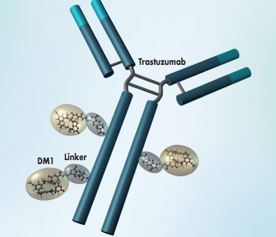
Trastuzumab-DM1 in HER2+ MBC
Trastuzumab-DM1
Antibody Drug Conjugate (ADC)
DM1
Maytansine (inhibitor of microtubule assembly)
Potency > vincristine or vinblastine
Maximal exposure of HER2+ tumors
Minimal exposure of normal tissues
Antitumor properties of trastuzumab
Lewis-Phillips GD, et al. Cancer Res. 2008;68(22):9280-9290.

Slide 30
TDM1 Randomized Clinical Trials in Advanced HER2-Positive BC
Current "standard of care" therapies in advanced disease
Taxane + Trastuzumab
Capecitabine + Lapatinib
Other Chemotherapies
+ Trastuzumab
? Superiority of TDM1 or TDM1 + P
Superiority of TDM1
Superiority of TDM1
TDM1 becoming the treatment of choice for all…!
(MARIANNE study)
(EMILIA study)
(TH3RESA study)
With excellent quality of life!
Side effects: ↑ live function tests, thrombocytopenia

Slide 31
Recent Progress in the Management of
Breast Cancer
Progress ?
↓
Yes
… with OS benefits
and little
toxicity
Chapter 2
HER2-
Positive
BC
Notes:
This evolution regarding breast cancer taxonomy parallels the technological evolution (I would say revolution) that we have been witnessing for several years and that we can use for molecular characterization of BC.
In the early 70’s we had just one marker, the ER.
In the 90’s we had two markers, the ER and HER2.
Today we have in our hands potentially several hundred of markers that can be used, and some of them are already used in the clinic for treatment decision making–see oncotypeDX.
But most importantly, tomorrow (and this is not very far from now), because of the dramatic and unpredictable technological and analytical advances (such as NGS etc…), it is expected that we will have in our office using our laptops or ipads, all the biological information needed for either treatment decision making or clinical research!

Slide 32
Recent Progress in the Management of
Breast Cancer
Chapter 3
Next generation
sequencing
for improved
treatment
"individualization"
Notes:
This evolution regarding breast cancer taxonomy parallels the technological evolution (I would say revolution) that we have been witnessing for several years and that we can use for molecular characterization of BC.
In the early 70’s we had just one marker, the ER.
In the 90’s we had two markers, the ER and HER2.
Today we have in our hands potentially several hundred of markers that can be used, and some of them are already used in the clinic for treatment decision making–see oncotypeDX.
But most importantly, tomorrow (and this is not very far from now), because of the dramatic and unpredictable technological and analytical advances (such as NGS etc…), it is expected that we will have in our office using our laptops or ipads, all the biological information needed for either treatment decision making or clinical research!

Slide 33
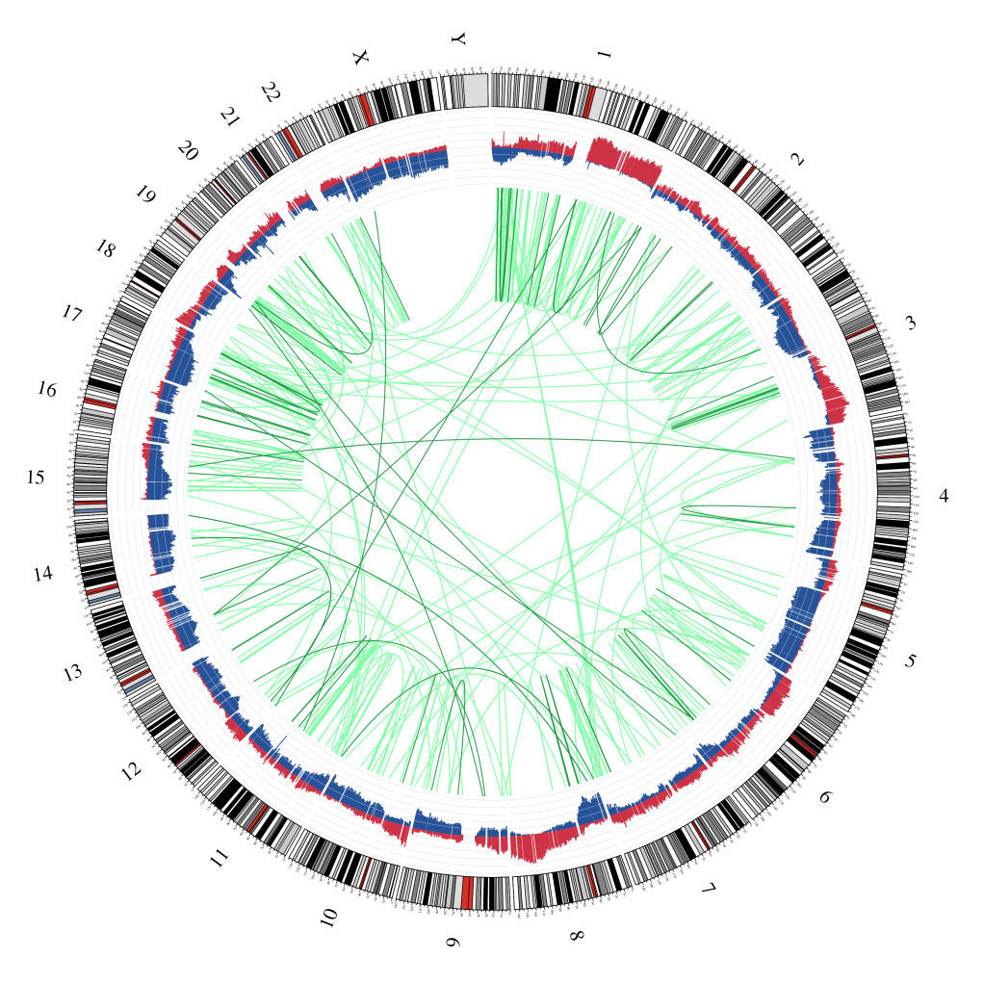
Directing “Personalized Therapy” on the Basis of “Genetic Tumor Markers”
Mutations
Copy n°changes
Rearrangements
NEXT GEN SEQUENCING

Slide 34
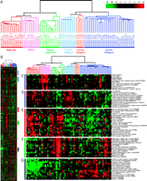
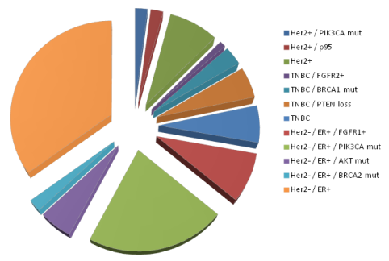
BC Is a Mixture of Several
RARE, “ORPHAN” Molecular Entities
Towards molecular segmentation!
More challenges in identifying a homogenous population
Notes:
But this is only the begging of the story…the tip of the iceberg since we are moving towards what I call BC molecular segmentation…
In fact the advances that we made during the last decade from genomic analysis indicate that BC cannot be seen only as a mixture of 4-5 molecular subtypes but rather as a mixture of SEVERAL, RARE and I would say ORPHAN molecular entities based on specific molecular abberartions.
Each one of these rare diseases may represent up to 1%- 10% of the overall breast cancer population.
Examples are shown here in this slide namely the FGFR1 amplification, PTEN loss, AKT mutation and BRCA1/2 mutations and several others that are expected to be discovered in the very near future!
34

Slide 35

2014-2017 BIG’s Program for MBC
The "AURORA initiative for advanced BC"
Goals: build a longitudinal map of the clonal evolution of BC diseases that interrogates the primary tumor as well as the metastases and accelerates new target drug development across Europe

Slide 36

Newly diagnosed or 1st-Line MBC Patients
‘Actionable’ Mutation(s) (n˷300)
Downstream targeted clinical trials as first or second line
Clinical outliers (exceptional responders and rapid progressors) to be subjected to WES
N = 1300
Screening
Failure
n = 300
‘Nonactionable’ Mutations (n˷700)
Standard of Care
….
Timeline
Continue until disease progression
Entry in DCT
Cycle 1
Cycle 2
Cycle 3
Cycle X
Disease
Progression
Metastatic Lesion
Biopsy – TGS (real time) and RNAseq (on batches)
Primary Tumor
Archival – TGS (real time) and RNAseq (on batches)
Blood
TGS (real time)
Plasma/Serum
Collection every 6 months – up to 10 years
Clinical Outcome Information
Collection every 6 months – up to 10 years

Slide 37
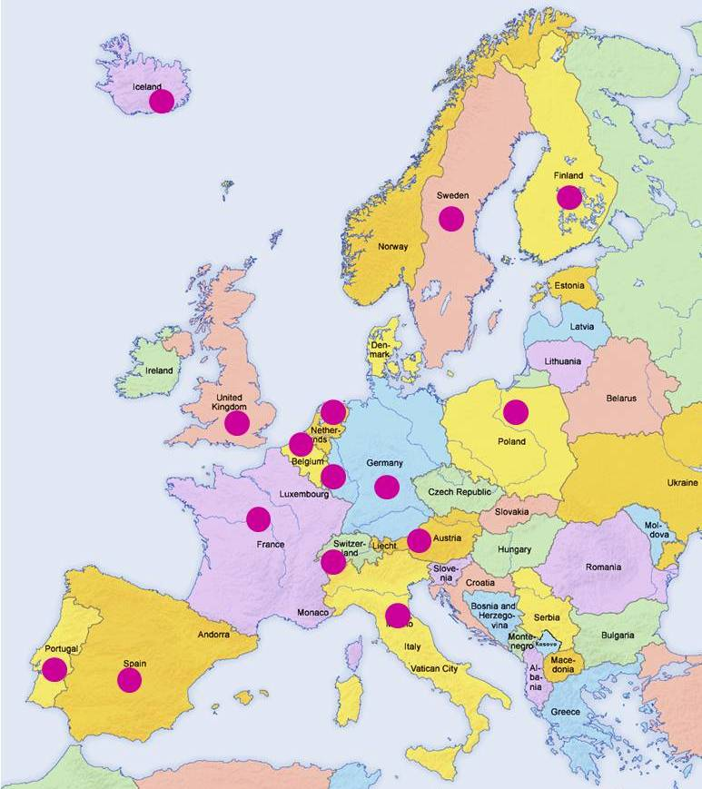

Participating Countries in AURORA (N= 15)
1
5
4
Intensified collaboration will be the only way towards progress in the era of molecular sequencing !
89 sites
in 15 countries
1
1
15
8
1
7
7
3
1
14
1
15

Slide 38
Recent Progress in the Management of
Breast Cancer
Chapter 4
Triple-
Negative
BC
Notes:
This evolution regarding breast cancer taxonomy parallels the technological evolution (I would say revolution) that we have been witnessing for several years and that we can use for molecular characterization of BC.
In the early 70’s we had just one marker, the ER.
In the 90’s we had two markers, the ER and HER2.
Today we have in our hands potentially several hundred of markers that can be used, and some of them are already used in the clinic for treatment decision making–see oncotypeDX.
But most importantly, tomorrow (and this is not very far from now), because of the dramatic and unpredictable technological and analytical advances (such as NGS etc…), it is expected that we will have in our office using our laptops or ipads, all the biological information needed for either treatment decision making or clinical research!

Slide 39
Olaparib Data in Breast Cancer
Tutt et al 2010; Ph II monotherapy olaparib in patients with BRCA1 or BRCA2 mutations and with advanced breast cancer (doses; 100 mg BD or 400 mg BD); Median 3 prior lines of chemotherapy. ORR for 400 mg BD 41% (11/27)
Gelmon et al 2011; Ph II monotherapy olaparib in patients with BRCA1 or BRCA2 mutations and with advanced breast cancer or ovarian cancer (dose 400 mg BD). Median 3 prior lines of chemotherapy overall – breast cancer patient more heavily pretreated. No RECIST responses for breast cancer patients – 38.5% had SD
Kauffman et al 2013; Ph II monotherapy olaparib in patients (multiple tumors) with BRCA1 or BRCA2 mutations (dose 400 mg BD). 62 breast cancer patients with median number of 6 prior lines of chemo. ORR for breast cancer patients = 12.9% (8/62); At 4 mo, disease control in 37% (23/62)
“OlympiA” is currently open in the adjuvant setting:
Olaparib for BRCAg TNBC
This agent may not be currently approved by the US Food and Drug Administration or European Medicines Agency for this indication.

Slide 40
Flow Chart - OlympiA Study Design
BRCA mutation carriers with
high-risk TNBC
Residual tumor
after neoadj chemo
Post adjuvant therapy
for node-positive disease
or T >2 cm if node-negative
Randomization
Olaparib (300 mg daily)
X 1 year
Placebo
X 1 year

Slide 41

GRACIAS!

